Slide 1
Machine Learning
CSE 403
Lecture 7
Classifier Performance Evaluation
Notes:
‹#›

Slide 2
Outline
Model evaluation & selection
Evaluating classifier accuracy
Metrics for evaluating classifier performance
Confusion matrix
Plotting an ROC curve

Slide 3
Model Evaluation & Selection
How can we measure accuracy?
Use test set of class-labeled tuples instead of training set when assessing accuracy.
Methods for estimating a classifier’s accuracy:
Holdout method, random sub-sampling
Cross-validation
Bootstrap
Comparing classifiers:
Confidence intervals
Cost-benefit analysis and ROC Curves

Slide 4
Evaluating Classifier Accuracy
Holdout method
Given data is randomly partitioned into two independent sets
Training set (e.g., 2/3) for model construction
Test set (e.g., 1/3) for accuracy estimation
Random Sampling
a variation of holdout
Repeat holdout k times, accuracy = avg. of the accuracies obtained

Slide 5
Evaluating Classifier Accuracy
Cross-validation
In k-fold cross-validation, the initial data are randomly partitioned into k mutually exclusive subsets or “folds,” D₁, D₂,..., D_{k}, each of approximately equal size. Training and testing is performed k times. In iteration i, partition D_{i} is reserved as the test set, and the remaining partitions are collectively used to train the model. That is, in the first iteration, subsets D₂,..., D_{k} collectively serve as the training set to obtain a first model, which is tested on D₁; the second iteration is trained on subsets D₁, D₃,..., D_{k} and tested on D₂; and so on.

Slide 6
Metrics for Evaluating Classifier Performance
True positives (TP)
These refer to the positive tuples that were correctly labeled by the classifier. Let TP be the number of true positives.
True negatives(TN)
These are the negative tuples that were correctly labeled by the classifier. Let TN be the number of true negatives.

Slide 7
Metrics for Evaluating Classifier Performance
False positives (FP)
These are the negative tuples that were incorrectly labeled as positive (e.g., tuples of class buys computer = no for which the classifier predicted buys computer = yes). Let FP be the number of false positives.
False negatives (FN)
These are the positive tuples that were mislabeled as negative (e.g., tuples of class buys computer = yes for which the classifier predicted buys computer = no). Let FN be the number of false negatives.

Slide 8
Metrics for Evaluating Classifier Performance
Confusion Matrix
A confusion matrix (also known as an error matrix) is a table that is often used to describe the performance of a classification model (or classifier) on a set of test data for which the true values are known. It allows the visualization of the performance of an algorithm
A confusion matrix is a summary of prediction results on a classification problem. The number of correct and incorrect predictions are summarized with count values and broken down by each class. This is the key to the confusion matrix.

Slide 9
Metrics for Evaluating Classifier Performance
Confusion Matrix
The confusion matrix shows the ways in which your classification model is confused when it makes predictions
It gives us insight not only into the errors being made by a classifier but more importantly the types of errors that are being made
TP and TN tell us when the classifier is getting things right, while FP and FN tell us when the classifier is getting things wrong

Slide 10
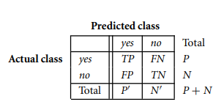
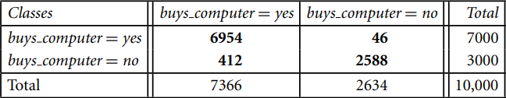
Metrics for Evaluating Classifier Performance
Confusion Matrix

Slide 11
Construct a Confusion Matrix
Consider the performance of a model that identifies lemons in an image filled with 20 lemons and 20 limes. With lemons as the positive class, the model correctly identifies 16 of the lemons but also incorrectly classifies 8 limes as lemons. The model also correctly ignores 12 of the limes but incorrectly fails to highlight 4 lemons.

Slide 12
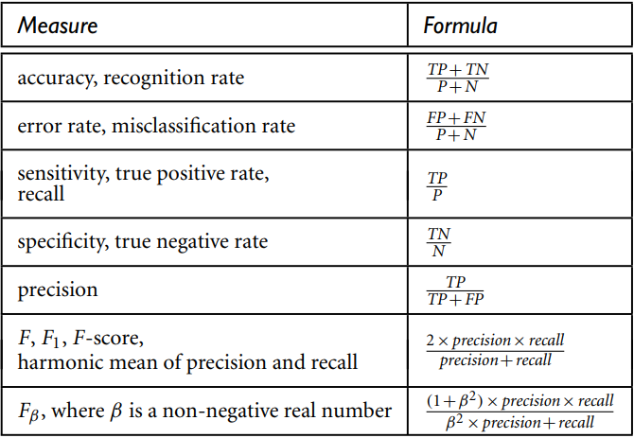
Metrics for Evaluating Classifier Performance

Slide 13


Precision is then calculated by dividing the number of true positives by the sum of true positives and false positives:
Recall is then calculated by dividing the number of true positives by the sum of true positives and false negatives:

Slide 14
Precision and Recall Trade-offs
Scenario 1: Email Spam Classifier
Precision matters more: Minimizing false positives is critical to avoid classifying important emails as spam.
Scenario 2: Cancer Detection
Recall matters more: Minimizing false negatives ensures that no cases of cancer go undetected.
Scenario 3:
weapon-detecting measures at airports to capture every possible positive, as a false alarm (a false positive) would be much more desirable than missing a threat (a false negative).

Slide 15
Precision and Recall Trade-offs
A trade-off exists when making improvements to precision and recall, as changes that improve one measure typically result in a decrease in the other.
For example, lowering the threshold for positive identifications would improve recall by making it less likely for the model to miss positive cases; however, it would also lead to a greater chance of false positives, causing a decrease in precision.
Increasing the identification threshold would have the inverse effect: the model’s precision would improve, but its recall would decrease through the higher likelihood of missing positive observations.
The F1 score balances this trade-off.

Slide 16
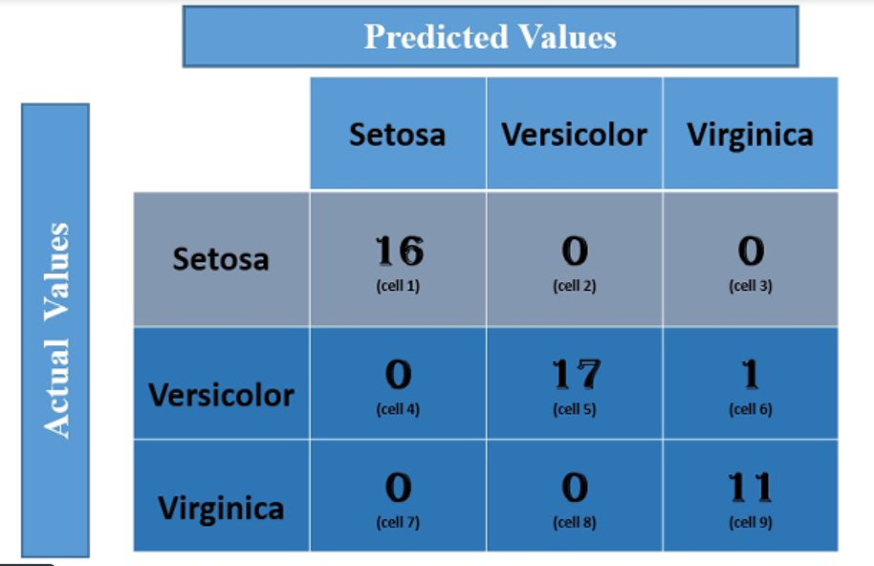
Multi Class Confusion Matrix
For class Setosa
TP: The actual value and predicted value should be the same. So concerning Setosa class, the value of cell 1 is the TP value.
TP=16
FN = (cell 2 + cell3)
= (0 + 0)
= 0
FP = (cell 4 + cell 7)
= (0 + 0)
= 0
TN = (cell 5 + cell 6 + cell 8 + cell 9)
= 17 + 1 +0 + 11
= 29

Slide 17
Multi Class Confusion Matrix
Similarly, for the Versicolor class, the values/metrics are calculated as below:
TP: 17 (cell 5)
FN : 0 + 1 = 1 (cell 4 +cell 6)
FP : 0 + 0 = 0 (cell 2 + cell 8)
TN : 16 +0 +0 + 11 =27 (cell 1 + cell 3 + cell 7 + cell 9).
For the Virginica class,
TP: 11
FN: 0 + 0 = 0 (cell 7+ cell 8)
FP: 0 +1 = 1 (cell 3 + cell 6)
TN: 16+0+0+17 = 33 (cell 1 + cell 2 + cell 4 + cell 5).
Total sample: TP + FN + FP+TN = 45

Slide 18
Measuring Evaluation Metrics
For the Setosa class:TP = 16, FN = 0, FP = 0, TN = 29
Accuracy_Setosa = (16 + 29) / (16 + 29 + 0 + 0) = 45 / 45 = 1
Precision_Setosa = 16 / (16 + 0) = 1
Recall_Setosa = 16 / (16 + 0) = 1
F1-score_Setosa = 2 * (1 * 1) / (1 + 1) = 2 / 2 = 1
For the Versicolor class:TP = 17, FN = 1, FP = 0, TN = 27
Accuracy_Versicolor = (17 + 27) / (17 + 27 + 0 + 1) = 44 / 45 ≈ 0.9778
Precision_Versicolor = 17 / (17 + 0) = 1
Recall_Versicolor = 17 / (17 + 1) = 17 / 18 ≈ 0.9444
F1-score_Versicolor = 2 * (1 * 0.9444) / (1 + 0.9444) ≈ 1.9706 / 1.9444 ≈ 1.0159
Accuracy = (TP + TN) / Total Sample
Or, Accuracy = (TP + TN) / (TP + TN + FP + FN)
Precision = TP / (TP + FP)
Recall = TP / (TP + FN)
Or, Recall = TP/P
F1-score = 2 * (Precision * Recall) / (Precision + Recall)

Slide 19
For the Virginica class:TP = 11, FN = 0, FP = 1, TN = 33
Accuracy_Virginica = (11 + 33) / (11 + 33 + 1 + 0) = 44 / 45 ≈ 0.9778
Precision_Virginica = 11 / (11 + 1) = 11 / 12 ≈ 0.9167
Recall_Virginica = 11 / (11 + 0) = 1
F1-score_Virginica = 2 * (0.9167 * 1) / (0.9167 + 1) ≈ 1.8333 / 1.9167 ≈ 0.9565
Overall Accuracy = (TP_Setosa + TP_Versicolor + TP_Virginica) / Total Samples = (16 + 17 + 11) / 45 ≈ 0.9778
Overall Accuracy = (TP_Setosa + TP_Versicolor + TP_Virginica) / Total Samples = (16 + 17 + 11) / 45 ≈ 0.9778
Average Accuracy = (Accuracy_Setosa + Accuracy_Versicolor + Accuracy_Virginica) / 3 = (1 + 0.9778 + 0.9778) / 3
Average Accuracy ≈ 0.9852
Average F1-score = (F1-score_Setosa + F1-score_Versicolor + F1-score_Virginica) / 3 = (1 + 1.0159 + 0.9565) / 3 ≈ 0.9908

Slide 20
ROC curve
ROC stands for Receiver Operating Characteristics,
and the ROC curve is the graphical representation of the effectiveness of the classification model.
It plots the true positive rate (TPR) vs the false positive rate (FPR) at different classification thresholds.
The TPR, or “Sensitivity”, is a measure of the proportion of positive cases in the data that are correctly identified as such. TPR = TP / TP + FN
or, TPR = TP/P
The FPR, or “Fall-Out”, is the proportion of negative cases incorrectly identified as positive cases in the data. FPR = FP/ FP+TN
or, FPR = FP/N

Slide 21
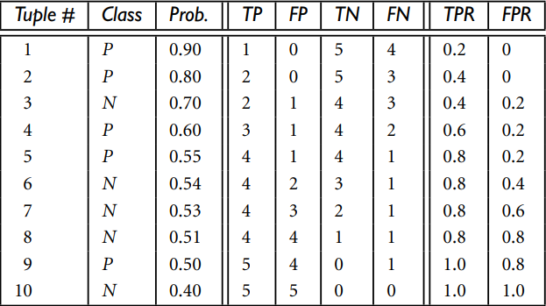
Plotting an ROC curve
1
0

Slide 22
Plotting an ROC curve
Receiver Operating Characteristics Curve
The figure shows the probability value (column 3) returned by a probabilistic classifier for each of the 10 tuples in a test set, sorted by decreasing probability order. Column 1 is merely a tuple identification number, which aids in our explanation. Column 2 is the actual class label of the tuple. There are five positive tuples and five negative tuples, thus P = 5 and N = 5. As we examine the known class label of each tuple, we can determine the values of the remaining columns, TP, FP, TN, FN, TPR, and FPR.

Slide 23
Plotting an ROC curve
We start with tuple 1, which has the highest probability score, and take that score as our threshold, that is, t = 0.9. Thus, the classifier considers tuple 1 to be positive, and all the other tuples are considered negative. Since the actual class label of tuple 1 is positive, we have a true positive, hence TP = 1 and FP = 0.
Among the remaining nine tuples, which are all classified as negative, five actually are negative (thus, TN = 5). The remaining four are all actually positive, thus, FN = 4. We can therefore compute TPR = TP/P = 1/5 = 0.2, while FPR = 0. Thus, we have the point (0.2,0) for the ROC curve.

Slide 24
Plotting an ROC curve
Next, threshold t is set to 0.8, the probability value for tuple 2, so this tuple is now also considered positive, while tuples 3 through 10 are considered negative. The actual class label of tuple 2 is positive, thus now TP = 2. The rest of the row can easily be computed, resulting in the point (0.4,0).
Next, we examine the class label of tuple 3 and let t be 0.7, the probability value returned by the classifier for that tuple. Thus, tuple 3 is considered positive, yet its actual label is negative, and so it is a false positive. Thus, TP stays the same and FP increments so that FP = 1. The rest of the values in the row can also be easily computed, yielding the point (0.4,0.2).

Slide 25
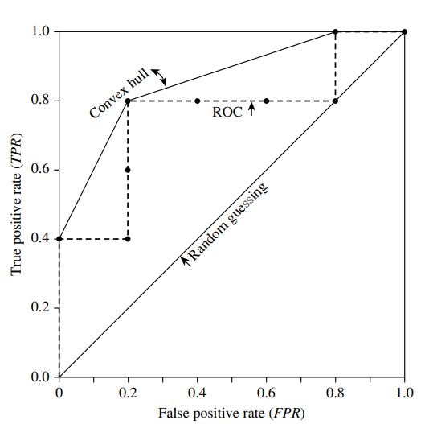
Plotting an ROC curve

Slide 26
AUC
AUC stands for the Area Under the Curve,
and the AUC curve represents the area under the ROC curve.
It measures the overall performance of the binary classification model.
As both TPR and FPR range between 0 to 1, So, the area will always lie between 0 and 1.
and A greater value of AUC denotes better model performance.

Slide 27
ROC and AUC
AUC - ROC curve is a performance measurement for the classification problems at various threshold settings.
ROC is a probability curve and AUC represents the degree or measure of separability. It tells how much the model is capable of distinguishing between classes.
Higher the AUC, the better the model is at predicting 0 classes as 0 and 1 classes as 1.
By analogy, the Higher the AUC, the better the model is at distinguishing between patients with the disease and no disease.

Slide 28
How to speculate about the performance of the model?
An excellent model has AUC near to the 1 which means it has a good measure of separability.
A poor model has an AUC near 0 which means it has the worst measure of separability.
In fact, it means it is reciprocating the result. It is predicting 0s as 1s and 1s as 0s.
And when AUC is 0.5, it means the model has no class separation capacity whatsoever.

Slide 29
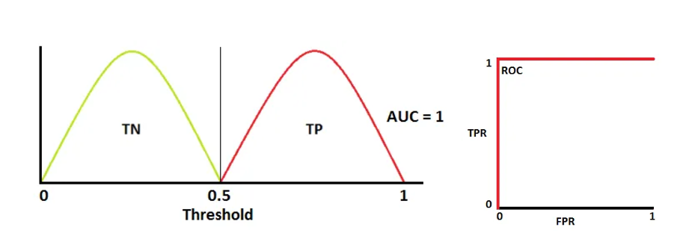
Red distribution curve is of the positive class (patients with disease) and the green distribution curve is of the negative class(patients with no disease).
This is an ideal situation. When two curves don’t overlap at all means model has an ideal measure of separability. It is perfectly able to distinguish between positive class and negative class.

Slide 30
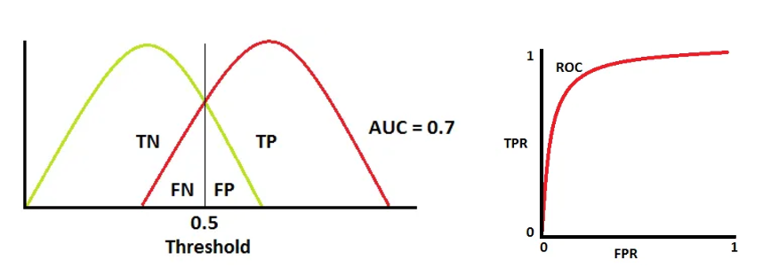
When two distributions overlap, we introduce type 1 and type 2 errors. Depending upon the threshold, we can minimize or maximize them. When AUC is 0.7, it means there is a 70% chance that the model will be able to distinguish between positive class and negative class.

Slide 31
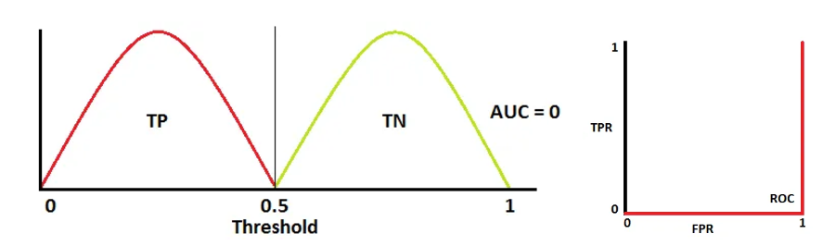
When AUC is approximately 0, the model is actually reciprocating the classes. It means the model is predicting a negative class as a positive class and vice versa.

Slide 32
When should we use the AUC-ROC evaluation metric?
There are some areas where using ROC-AUC might not be ideal.
In cases where the dataset is highly imbalanced, the ROC curve can give an overly optimistic assessment of the model’s performance.
This optimism bias arises because the ROC curve’s false positive rate (FPR) can become very small when the number of actual negatives is large.
ROC curves may be appropriate when the cost of False Positives and False Negatives is balanced and the dataset is not heavily imbalanced.

Slide 33
Task
Class | N | N | P | P | N | P | P | N | P
Probability | 0.95 | 0.71 | 0.48 | 0.78 | 0.55 | 0.90 | 0.82 | 0.93 | 0.25
Draw a Receiver Operating Characteristic (ROC) curve using the above data where minimum threshold is 40%.

Slide 34
Thank You

